Slide 1
Lab 3: Wall Following In Tesse
Isaac, Joshua, Lilly, & Mario

Slide 2
01
Introduction
Set Up & Goals

Slide 3
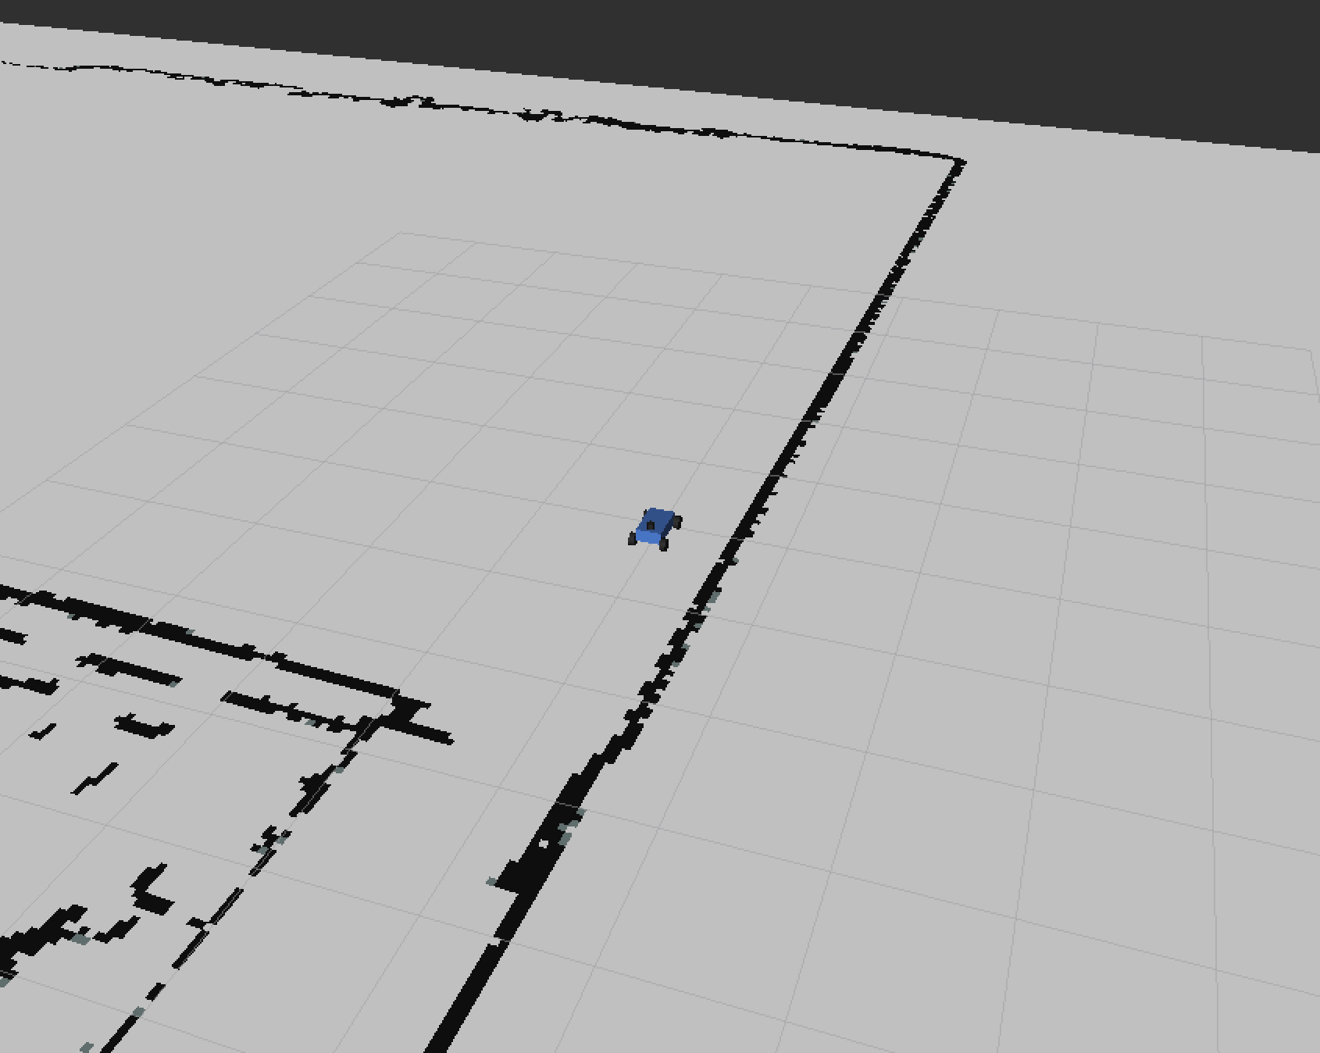
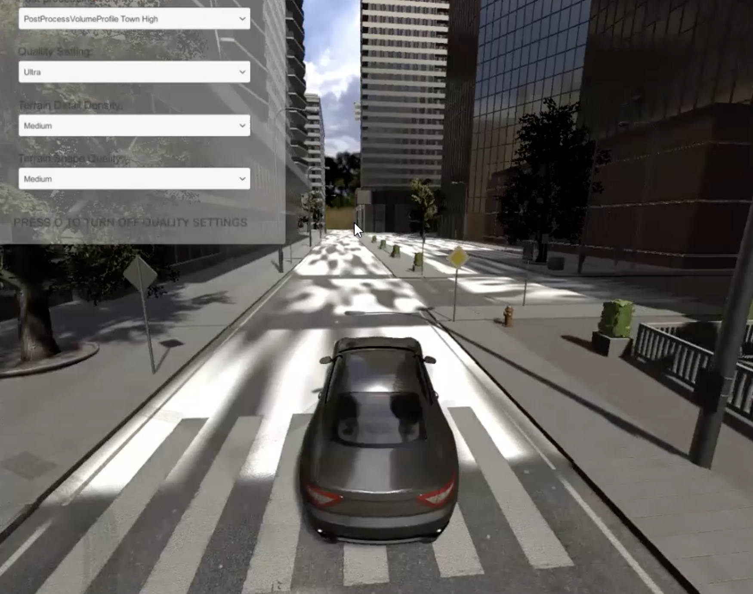
Modified a wall following controller successful in 2D environment to function in 3D.
2D Environment from Previous Lab
3D Photorealistic TESSE Environment

Slide 4
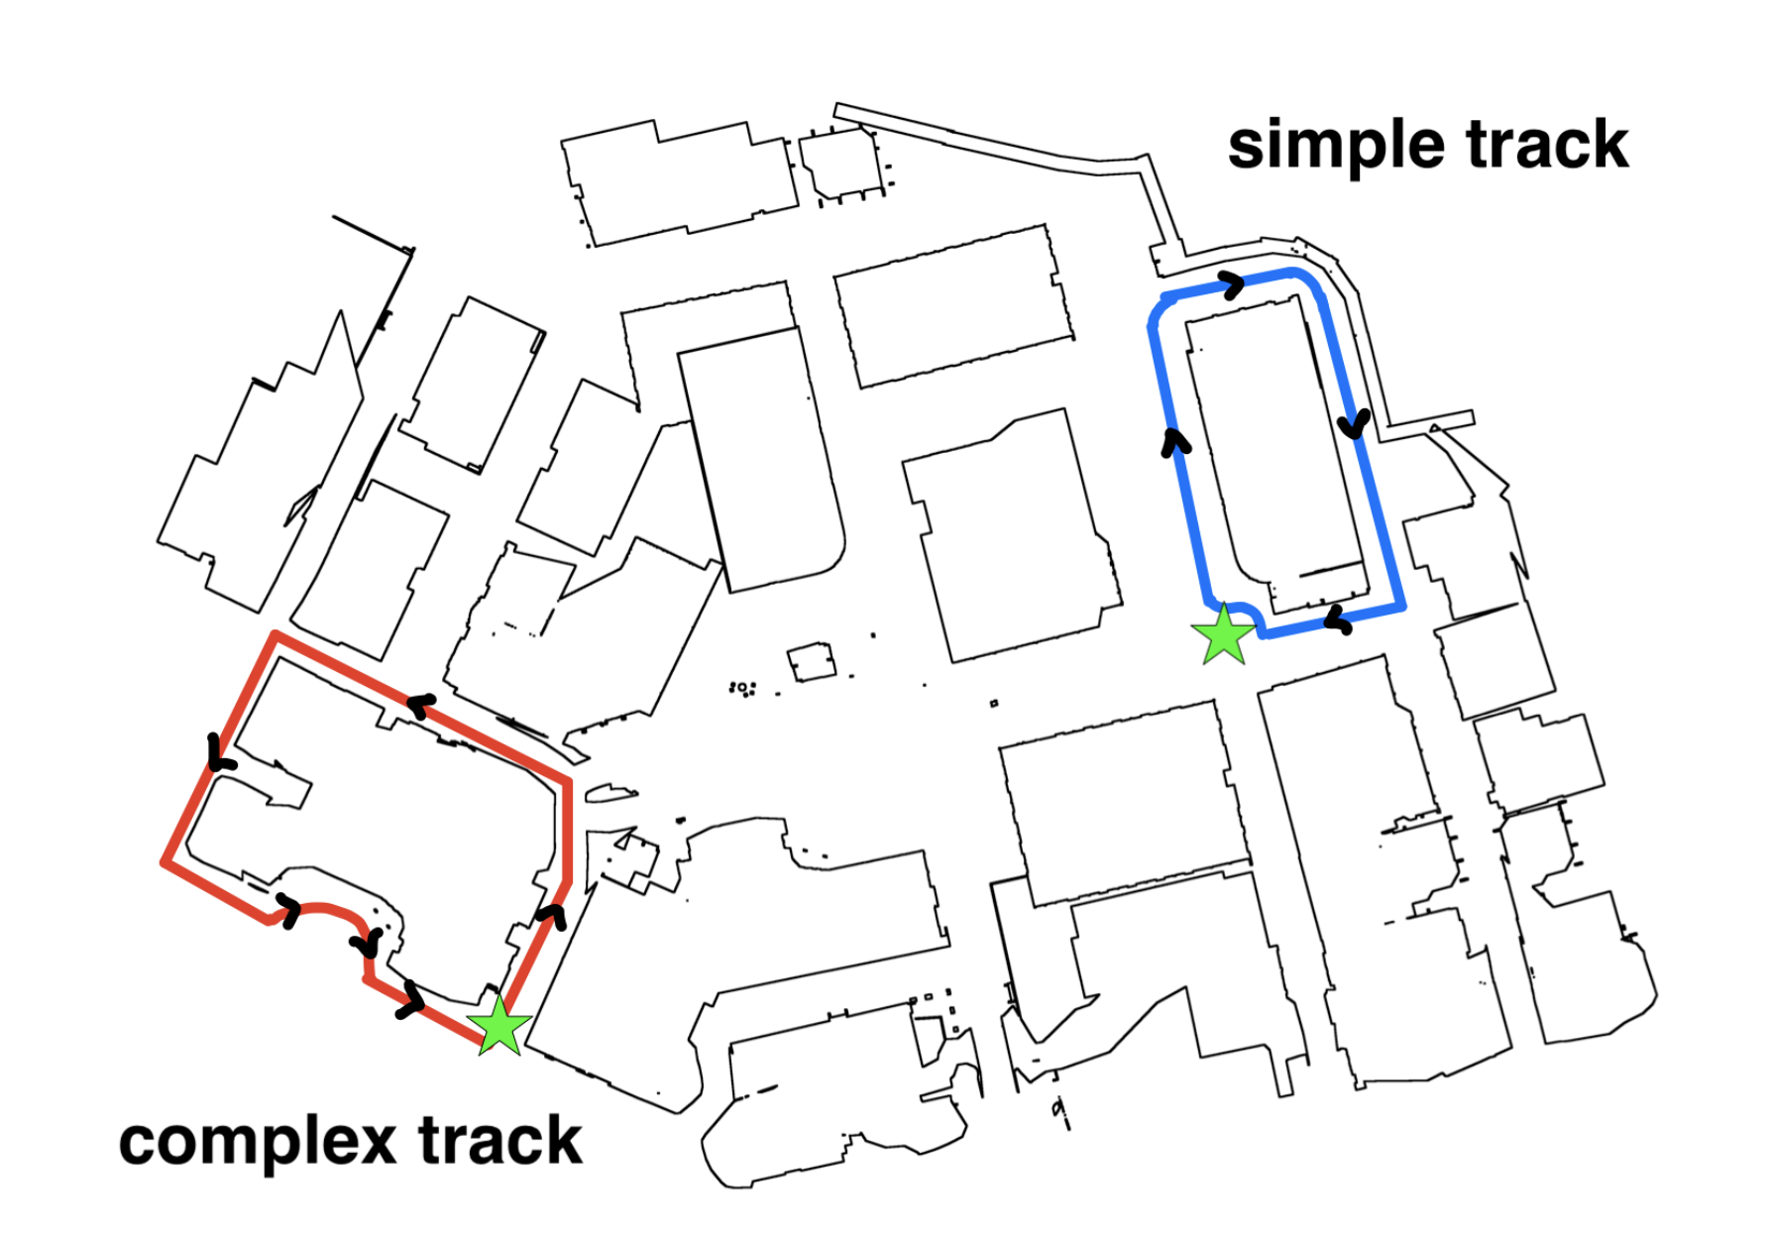
The goal
Complete two tracks autonomously without collision
https://github.com/mit-rss/wall_follower_tesse

Slide 5
02
Technical Approach
Scan > Identify > Control

Slide 6
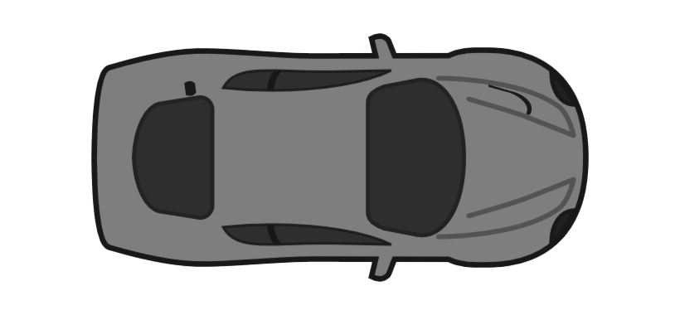
Scan and WALL ID
x
Slice laser scan in half
Filter outliers
Least Squares Linear Regression
+y
*Representation of LIDAR scan data

Slide 7
Control
Desired Distance
PID Control: proportional, integral, differential
Input: Distance vs Angle
Output: Steering Angle
Timestep
𝚹
Robot
x-intercept
Wall: y=mx+b
*Look-Ahead Method

Slide 8
03
Experimental Evaluation

Slide 9
Experimental Results
Track
Successful Runs
Stability
Only tested on the simple track
Successfully completed 3 runs
Large oscillations with minor mistakes

Slide 10
Current Progress
Currently we are trying to tune and revise our PID controller for the complex track

Slide 11
04
Conclusion
Current Lab Takeaways & Future Plans

Slide 12
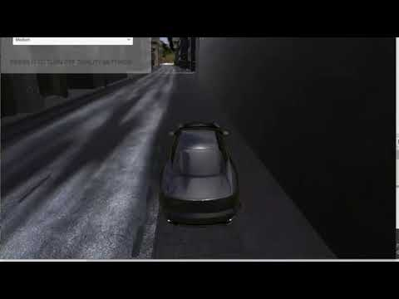
Lessons / Strategies learned
Pursue bite-sized problems
before more complex ones
“Theory” doesn’t always translate to real-life lab conditions

Slide 13
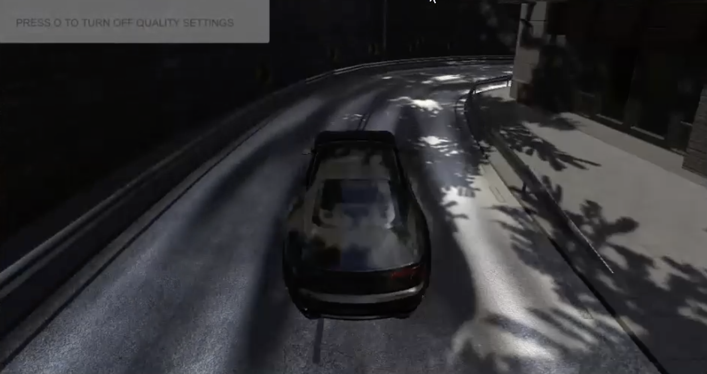
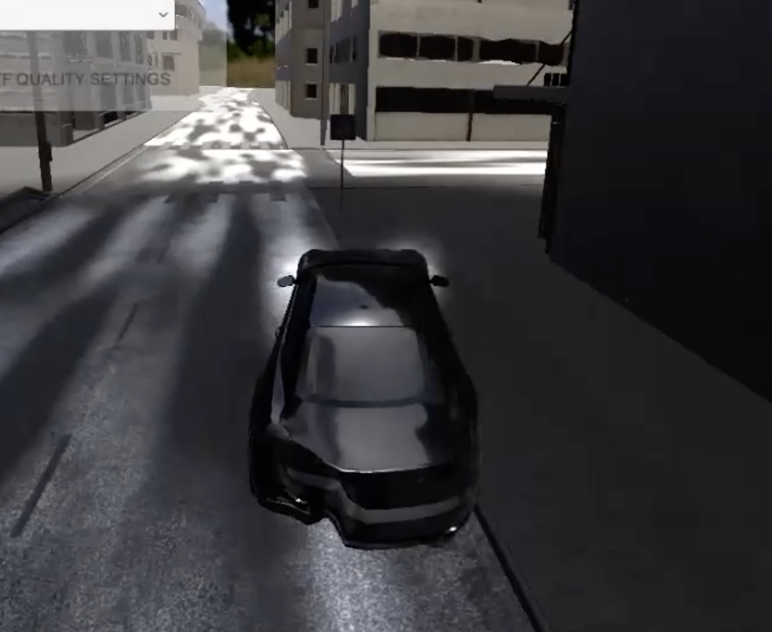
plan for future action 🛠️
Continue tuning PID
Design “look-ahead” code for complex track / atypical turns
Program in track-specific features

Slide 14
Questions?

Slide 15


